Slide 1

Inverse kinematics solving
Ir. Mohayad Omer (mohayad.abdelmonim.mahmoud.omer@vub.be)
Ir. Chaoyue Fei (chaoyue.fei@vub.be)
Robotics and Multibody Mechanics, Vrije Universiteit Brussel, Belgium

Slide 2
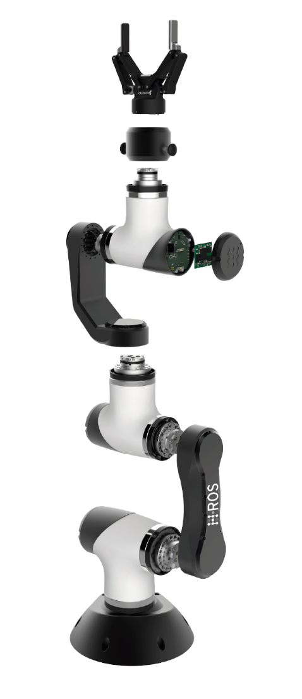
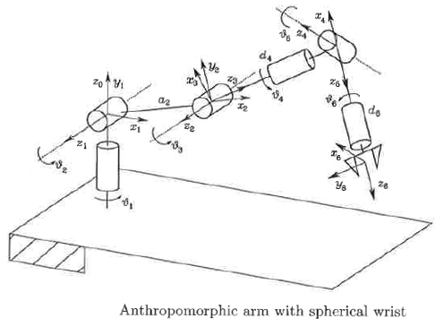
KINEmatic in robotics
Property of motion of a rigid body.

Slide 3
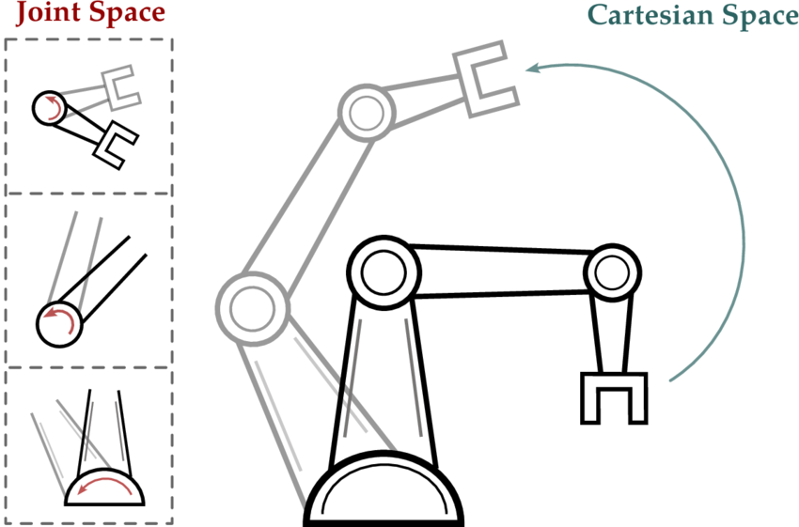
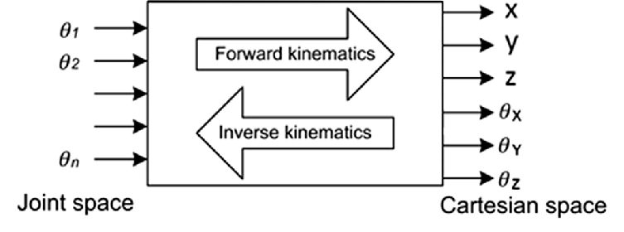
Operational vs joint space

Slide 4
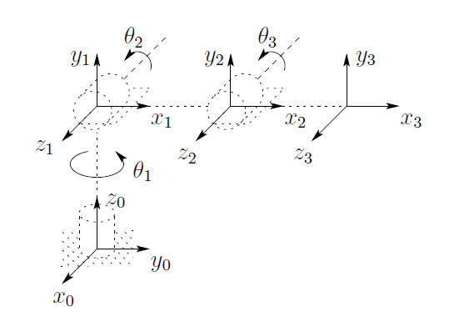



KINEmatic chain
Transformation matrix:

Slide 5
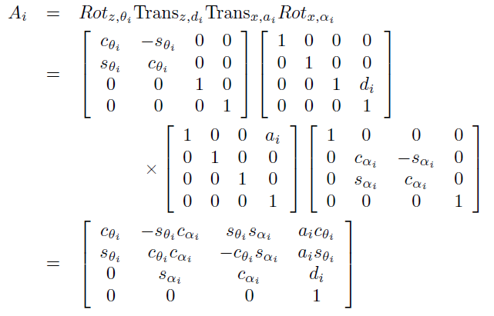
Dh convention
Denavit-Hartenberg: provides a systematic procedure to perform forward kinematics
Each homogeneous transformation is represented by a product of four basic transformations:

Slide 6
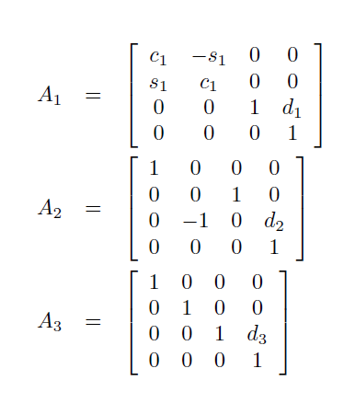
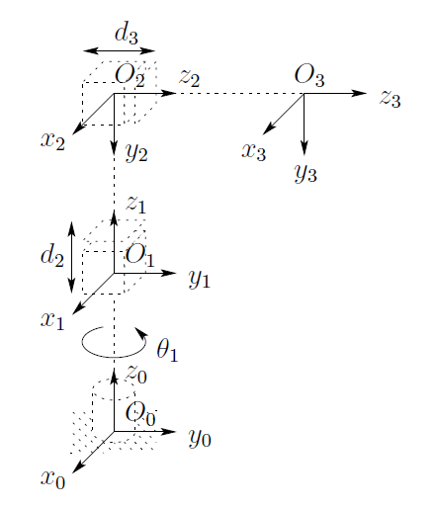
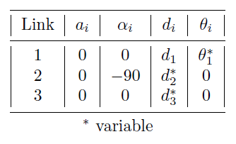
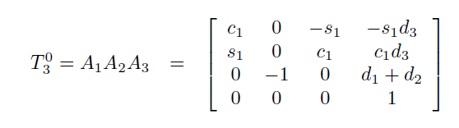
Dh FRAMES - EXAMPLE

Slide 7
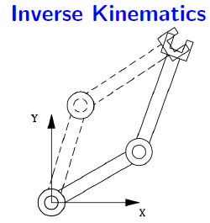

IK problem
Input: End-effector position and orientation
Output: Robot’s joint angles
Given the 4x4 homogeneous transformation:
Where:
12 equations to solve!!

Slide 8
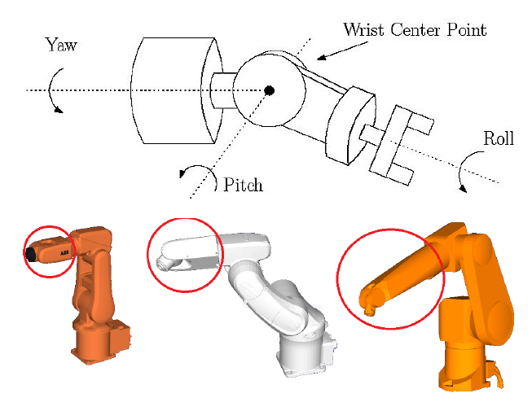
KINEMATIC DECOUPLING
Wrist: joints between the arm and end-effector
Spherical wrist: axes of the three last joints intersect at one point.
Notes:
Spherical wrist: A three degree of freedom rotational joint with all three axes of rotation crossing at a point is typically called a spherical wrist.

Slide 9
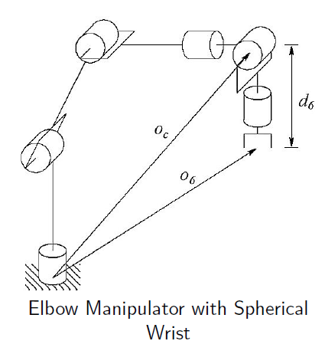
KINEMATIC DECOUPLING – iNVERSE POSItion
Spherical wrist -> position of wrist center point Oc independent on the end-effector orientation.
Orientation of end-effector depends on the last three joints.
Kinematic decoupling: solving the IK of a 6 dof manipulator splits in two problems:
Inverse position kinematics
Inverse orientation kinematics

Slide 10

Whats next?
1) Check and run the FK example using DH
2) Derive the DH table for the MARA
3) Perform Kinematic decoupling for the mara
→Robot Modeling and Control: Chapter 3.3.2

Slide 11
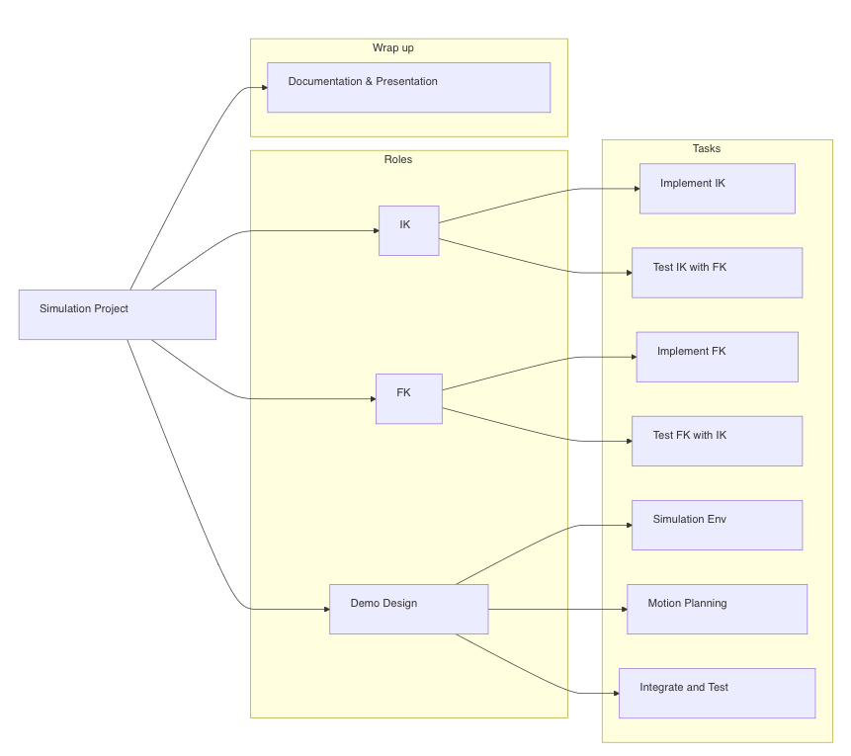

Slide 12
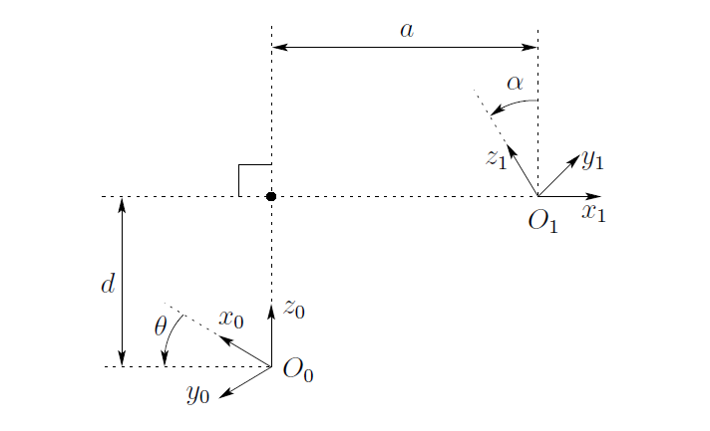
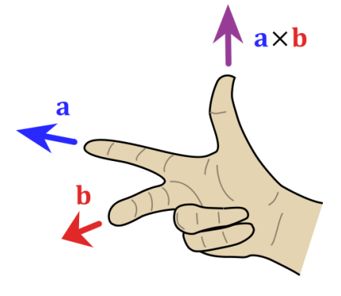
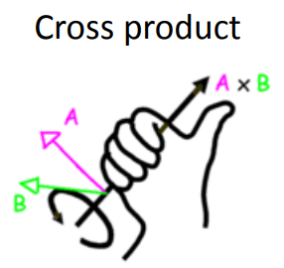
Dh CONDITIONS
d - the distance between the previous x-axis and the current x-axis, along the previous z-axis.
θ - the angle around the z-axis between the previous x-axis and the current x-axis.
a - the distance between the previous z-axis and the current z-axis
α - the angle around the common normal between the previous z-axis and current z-axis.

